Slide 1
How do neurons communicate?
Notes:
General Objectives:
Learn that the brain is made of cells.
Learn that there are different types of cells. (While the specific names/functions are introduced, this should not be the focus, instead focus on the fact that not all cells are the same, each has their own specialized function.)
Introduce the concept that neurons are sending signals in our brain and body.
Understand that cells are small, we cannot see them with our eyes alone.
Introduce microscopes as a tool used by neuroscientists to see cells.
Tips for Timing
If you are often running out of time, to shorten this presentation you can skip the detailed descriptions of cell types other than the neuron.
If you haven’t presented “What are our brains made of?” activity, spend more time on early “REVIEW” slides.
Another good example of neuronal networks is social media, like Facebook. If you have 4 friends on facebook, and each of those friends has another 4 friends, then you are connected indirectly to 16 people and directly to 4 people. So if you share a photo on each of your friends’ walls, you will have reached 20 people with that photo. This is how one neuron can activate many others!

Slide 2
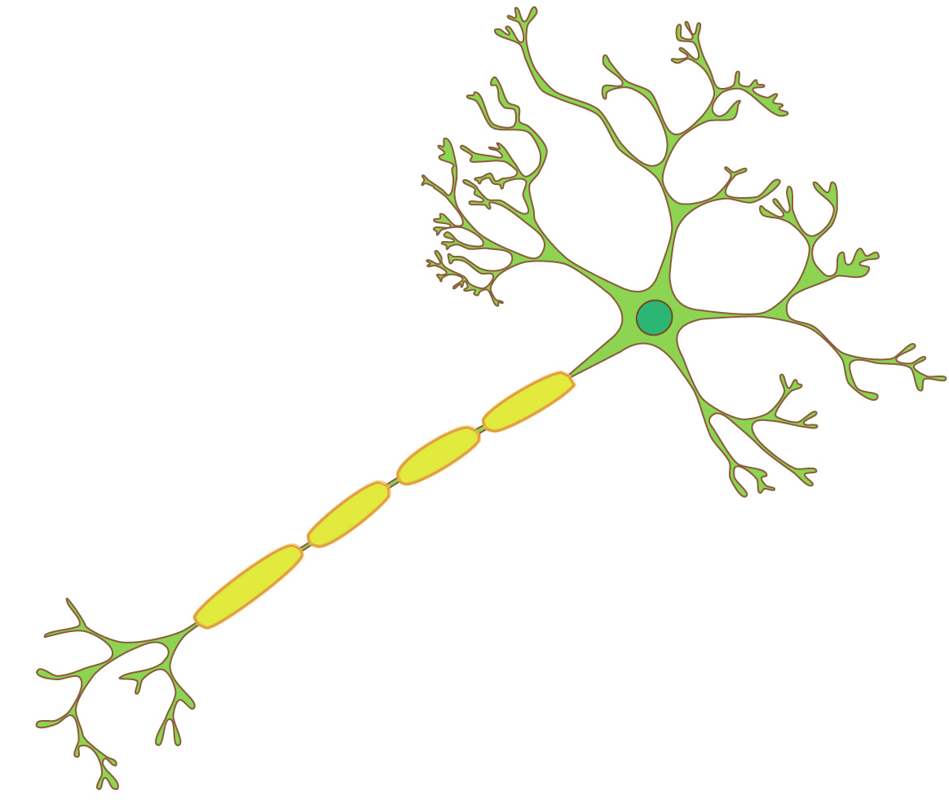
Neurons
Dendrites
Axon
Cell Body
Notes:
Slide 2: Review from activity “What are our brains made of?”
This is a cartoon of a neuron. What makes it unique from other cells in the body is that it has long processes (arms) that it using to communicate with the other neurons and pass information throughout the body. These cells are only able to be seen through the use of a microscope, which can magnify what you are looking at many, many time, like a magnifying glass.
Go through the 3 main parts of the neuron: the cell body, the dendrites, and the axon. You can go over this a second time having the students say out loud each part as you point to it.
You might also try using hand gestures for the different parts of a neuron. Ex: put hands up in the air and wiggle fingers for “dendrites” (receiving information), pull arms close to bodies and do cyclic motion for “cell body” (processing the information), and then push arms forward for “axon” (sending the information).

Slide 3
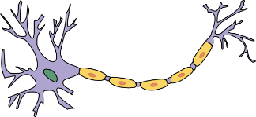
What is a Neuron? “The Messengers”
Transmit information to help us do everyday activities like walk, see, hear, and think
http://www.fmengert.net/
http://i1-news.softpedia-static.com/images/
Notes:
Slide 3: Review of neuron function
Neurons are the wiring system of the brain. They communicate by sending signals to each other. These signals are what let us do activities like walk, see, think, and hear.
One neuron can be connected to many other neurons forming what we call a network.
The brain has about 100 billion neurons. If they were all lined up, they would take up 1000 km, which would take about 200 hours (8.3 days) to walk.
Fun fact: There are more neurons in the human brain than there are stars in the Milky Way!

Slide 4
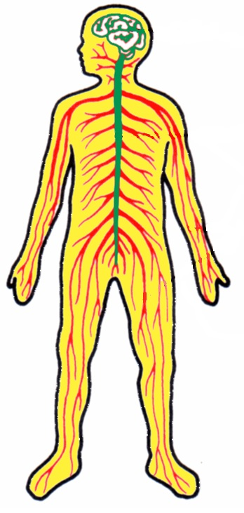
Neurons send signals:
Within the brain
From the brain to the body
From the body to the brain
Longest
Axon
Notes:
Slide 4: Neurons can send signals!
Neurons send signals within our brain and spinal cord, from the brain to the body, and from the body to the brain.
The longest axon in the human body extends from the bottom of the spine to the big toe. In adults this is about 3 feet!
Quick activity: Using two students as volunteers (one who measures and one who is measured), measure this length using a string, and then determine the length using a metre stick or ruler.

Slide 5
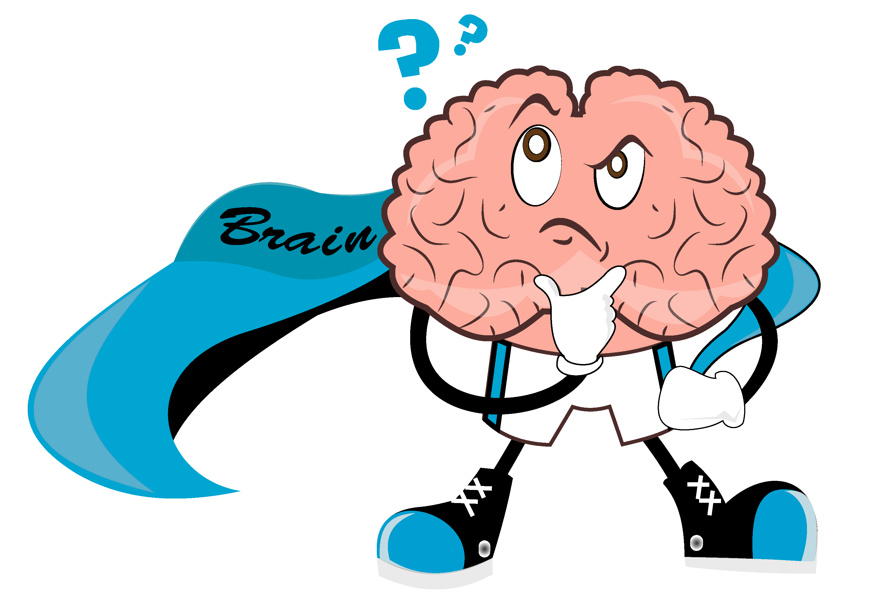
Brainstorming!
How do you think neurons communicate?
Notes:
Slide 5: (~5-7 min) Activity
Goal of Activity: To learn that neurons are a type of cell in our bodies that is very small, that is found in large number in the body, and that can communicate with one another and are able to send messages all across the body.
Activity Instructions for Teachers: Ask students the following questions, allowing them some time to think and answer. Help and prompt them. If they struggle to find an answer, tell them the answer below.
1) How big is a cell?
Smaller than we can see without help!
The diameter of a neuron ranges from 4 µm (=“micrometres”, =0.001mm) (granule cell, which communicates between other brain cells) to 100 μm (motor neuron, which sends messages from the brain to the muscles). Length can reach up to several feet (axons).
2) How many cells are in the brain (human)?
Older figures state the brain contains about 100 billion neurons and 500 billion glial cells (supporting cells that keep neurons healthy). More recently, several studies have suggested that the ratio of glial cells to neurons is actually much lower: about 1 billion neurons and 1 billion glial cells.
3) How do neurons communicate?
A: Neurons can send signals to each other electrically, like a computer circuit, or by releasing chemicals that activate other cells (like how chemicals from the outside world activate the cells in your nose to make you smell something).

Slide 6
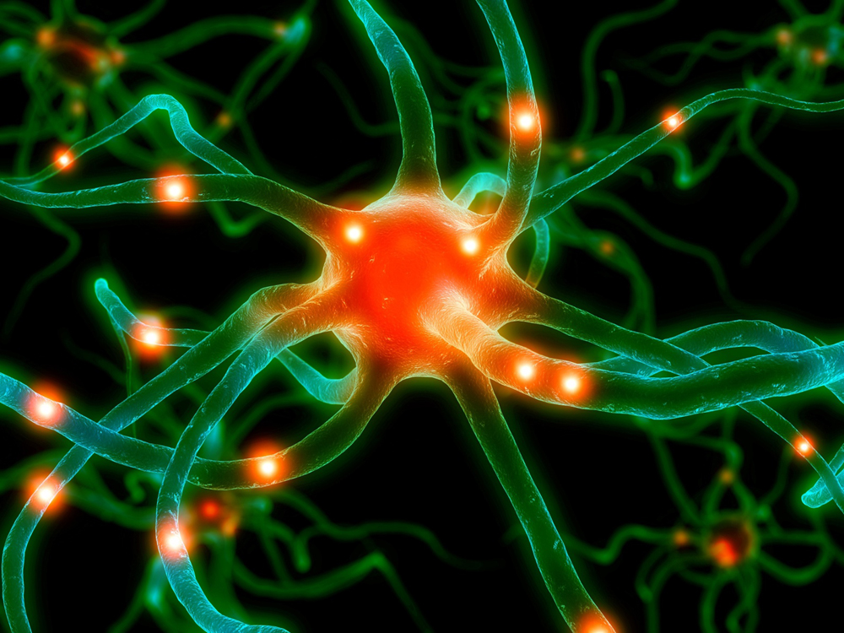
Activity: Neuron Network!
Notes:
Slide 6: (~ 5 -10min) Activity
Goal of Activity: To illustrate how neurons make connections with each other to pass along signals. One neuron can be connected to thousands of other neurons, forming a neuronal network.
Activity Instructions for Teachers: Get everyone to join hands in a line. Starting at one end, get the student to squeeze the hand on the person next to them, when they feel the squeeze they squeeze the hand of the person next to them and so on. Ask the following questions and provide answers below.
1) Can they pass signals faster? How fast do signals in the brain travel?
Answer: up to 100-150 m/s depending on the source you read
2) What happens if one person doesn’t squeeze the next person’s hand?
Answer: the signal will not be sent down that pathway that lies next.
3) How can neurons send signals to many different places at once?
Answer: With branching! Neurons can connect with multiple other neurons, not just one at a time! You can repeat the activity with a branch point (one person grabbing two people’s hands and sending the “signal” one or both ways) to introduce the concept of a network.
Note: Some students may suggest that the signals travel at the speed of light. This is not true; neuronal signals travel much slower.

Slide 7
What Did We Learn Today?
The brain is made of different types of cells called neurons
There are different types neurons that have different functions
Neurons can send signals all throughout the brain by communicating with one another
Notes:
Slide 7: What did we learn today?
Take Home Message:
Learn that the brain is made of cells.
Learn that there are different types of cells. (While the specific names/functions are introduced, this should not be the focus, instead focus on the fact that not all cells are the same, each has their own specialized function.)
Introduce the concept that neurons are sending signals in our brain and body.
Understand that cells are small, we cannot see them with our eyes alone.
Introduce microscopes as a tool used by neuroscientists to see cells.

Slide 8
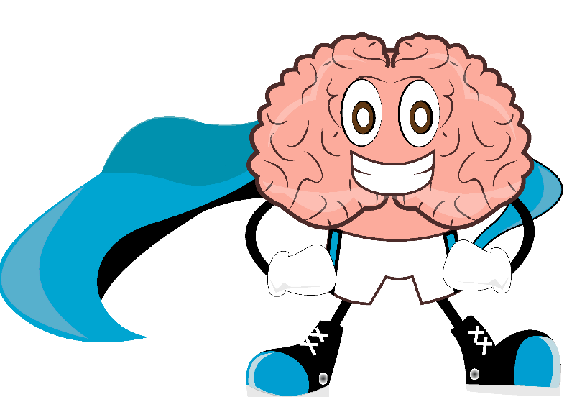
questions@brainreachnorth.com
www.brainreachnorth.com
Notes:
Thanks for using the lesson! Please contact the BrainReach North team anytime at questions@brainreachnorth.com if you or your students have further questions about this topic or activity.
You can provide feedback on this lesson plan using this form: http://goo.gl/forms/oi0ofj03HM

