Slide 1
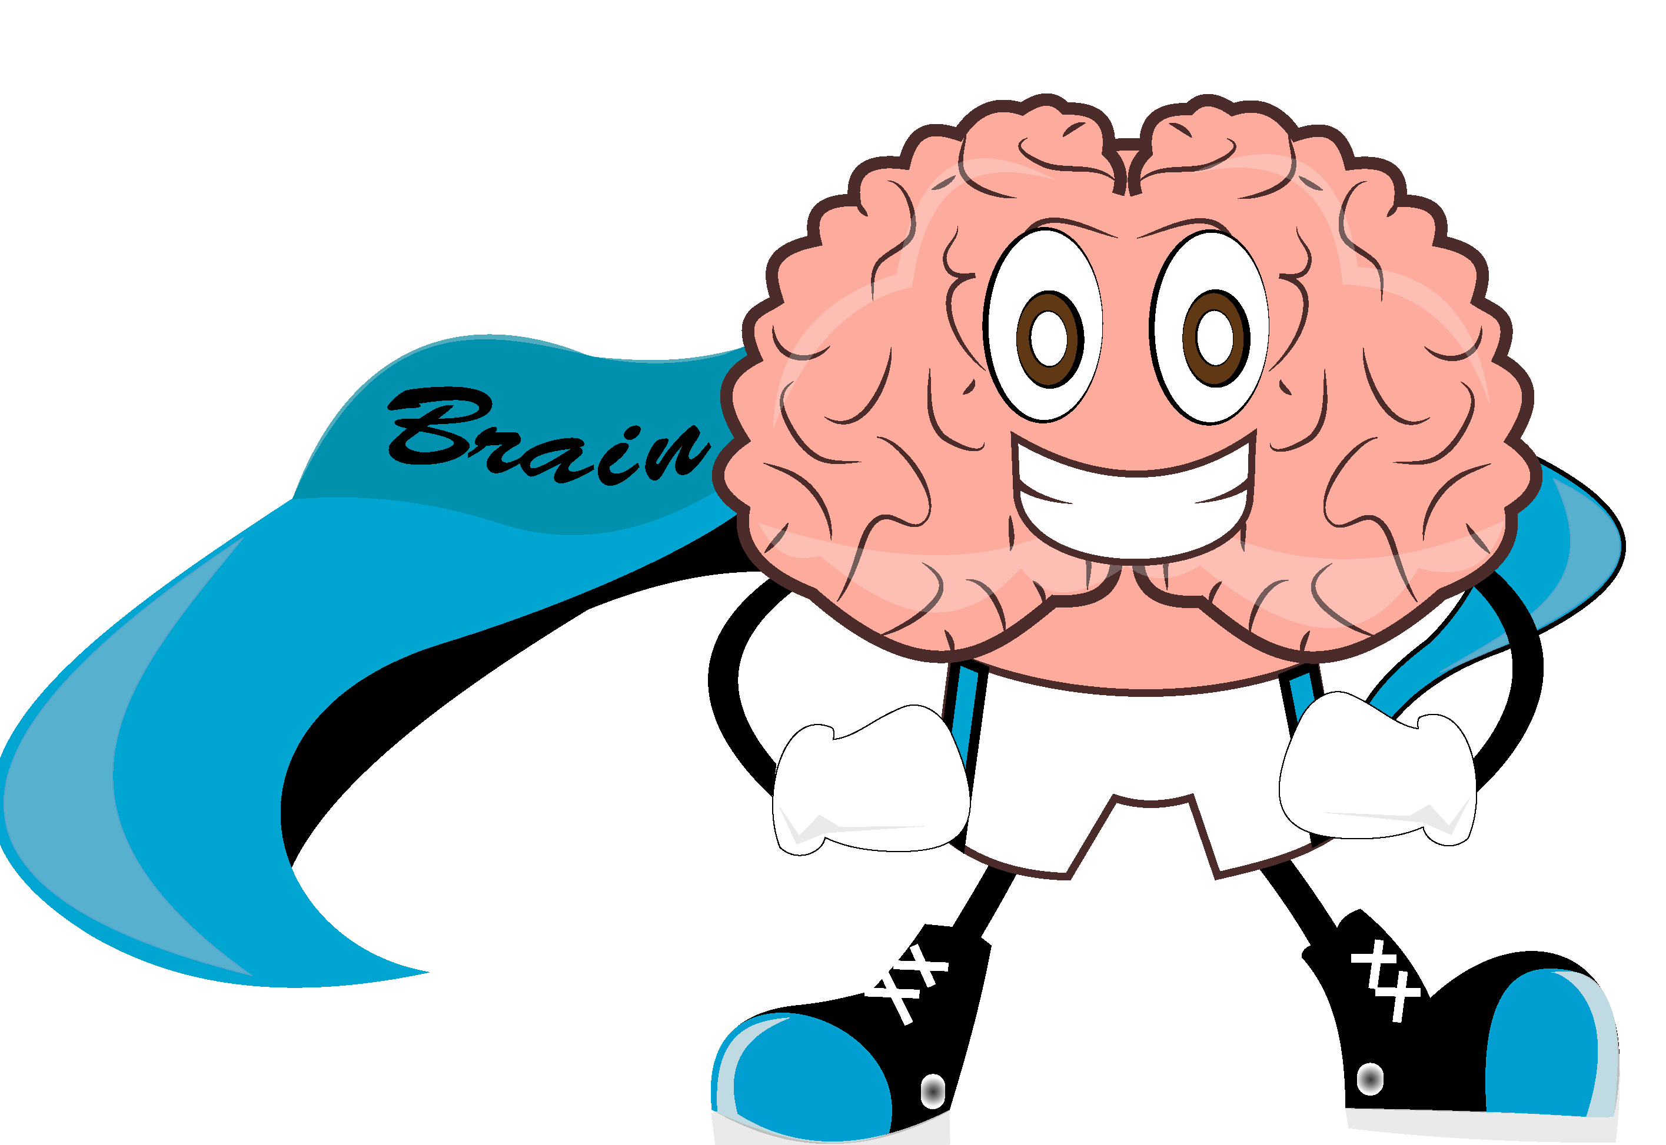
Logical Fallacies

Slide 2
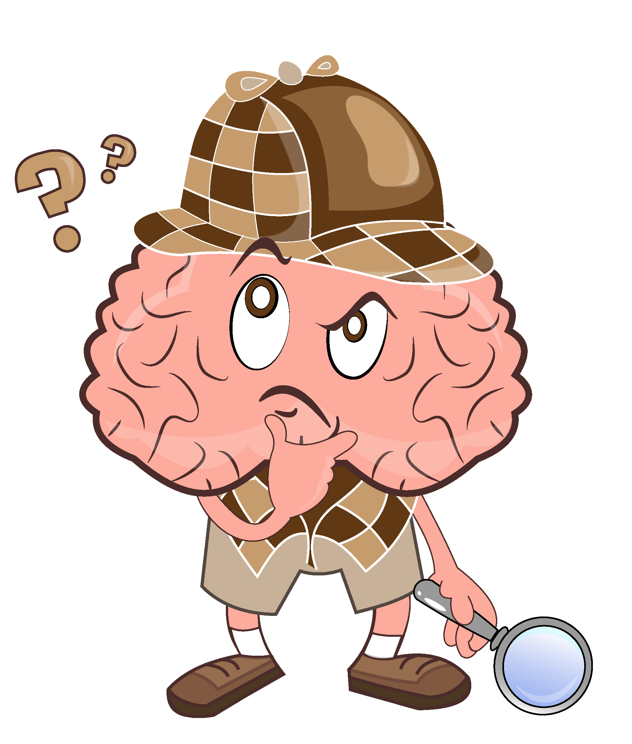
Scientific Methods
Science is one way to try to understand the world around us.
Question
Hypothesis
Experiment
Check hypothesis
Conclusion
Notes:
Science is one way that tries to understand how the world around us works. It creates knowledge based on observations and experimental evidence. To do that, scientists follow scientific methods that consist of several steps. EXPLANATIONS (Question -> hypothesis -> experiment -> check hypothesis -> conclusion).
So what is logic and why is it important in science?

Slide 3
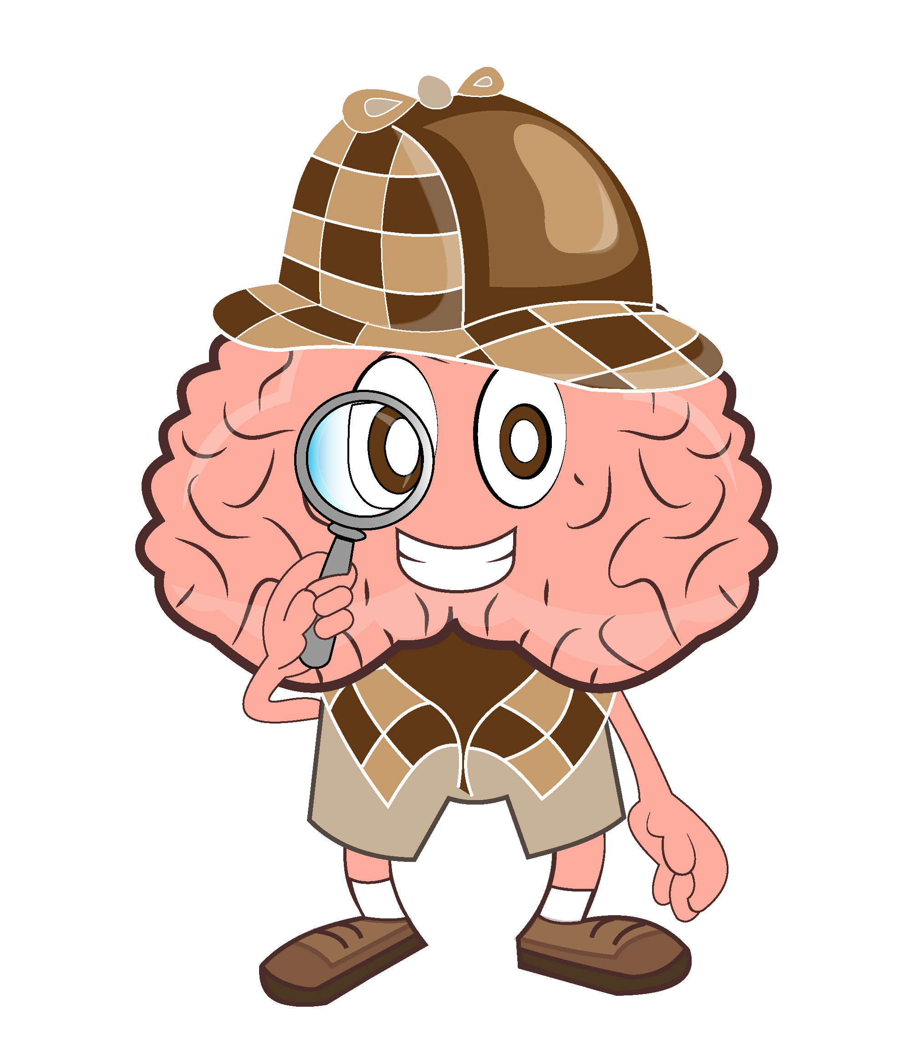
What is Logic?
- the study of VALID REASONING
It is an important part of science because if we make mistakes in our thinking (reasoning), then we might draw wrong conclusions…
Notes:
Lets begin with a question that you may all think you know the answer to. Do you know what logic is? It is the study of valid reasoning or we could say “correct thinking”. Logic is an important part of science because if we make mistakes in our thinking when we design our experiments (we do a wrong experiment to check our hypothesis) or when we interpret the results we get from our experiments, we will arrive at the wrong conclusion. Then we will have mistaken in how we see the world!

Slide 4
“Deductive reasoning” is one type of reasoning
This is similar to following a recipe…
If you follow granny’s cookie recipe exactly step by step, you will always get granny’s cookies.
Consider this:
“All students study”
“Alan is a student”
THEREFORE, you can figure out (“deduce”) that:
“Alan studies”
This is must be true if the first two statements are true.
Notes:
For example, you want to make cookies like your granny does and you borrow her recipe, which you have used before and you get the cookies exactly as you like them (you can’t get something different by the same recipe). This is similar to what in logic is called “deductive reasoning”…if you exactly follow the recipe, you will get the cookies exactly as your grandma’s. So for instance, we have the two statements, “All students study” and “Alan is a student”. If both of these statements are true, then it must also be true that “Alan studies”.
This is the only logical conclusion if the two previous statements were true, just like how the only result of following a cookie recipe exactly right is a certain kind of cookies.

Slide 5
“Inductive reasoning” is another type of reasoning
Back to the kitchen… your younger sister knocked some extra sugar in your mix but doesn’t tell you.
But… you are a distracted person and other times you’ve tried to make the cookies you have put extra sugar in by mistake. Because you don’t have all the information, you might conclude that this is probably what happened this time.
You might be right, but you might be wrong…
So if:
“Most students study” and “Alan is a student”
Then,
It’s likely that “Alan studies”
Notes:
Back to the kitchen where you were making cookies. While you were in the bathroom, your younger sister knocked some extra sugar in the mix by mistake but didn’t tell you… When you taste the cookies, you realize that they taste different from how they normally taste, they are sweeter.
You might conclude that if they are sweeter you must have put some extra sugar by mistake, because you know that sometimes you are distracted and this has happened to you before. This is called “inductive” reasoning. In other words, you come to a probable conclusion about what happened based on the fact that the cookies are sweeter than usual, and that you have added extra sugar on previous occasions.
This conclusion could have been right – in this case we know that it is wrong, but that doesn’t mean the reasoning is flawed. This is what happens when you don’t have all the information about a situation. The conclusions can be true or false.
So for instance, if “most students study” and “Alan is a student”, then we can conclude that “Alan probably studies”. But it is also possible that he doesn’t study.

Slide 6
Easy enough, huh?
Actually, our brains are not always so logical.
Sometimes they take shortcuts and make us jump to conclusions that are not correct.
This is what is called a “logical fallacy”
Notes:
Logic helps us make sense of the world and express it to others so that it is also reasonable to them. Although our brains are good at doing this, it does sometimes take shortcuts and sometimes our emotions can make us jump to conclusions that are not entirely correct. When we make these errors, we say that we committed “logical fallacies”.

Slide 7
Logical fallacies can be made by mistake, but sometimes they are done on purpose to try to convince people that their idea or argument is right.
Notes:
Logical fallacies can occur by mistake but they can also be made intentionally to try to convince people of an argument or idea. It is important to be aware of logical fallacies, so that you can distinguish sound arguments from flawed ones, and not be easily manipulated in thinking. Sometimes it is hard to recognize them. Let’s take a look at a few examples!

Slide 8
Fallacies of relevance include information that is irrelevant to the conclusion but is given to persuade you of the conclusion
Consider this:
“Sofia says that chess is a sport.”
“Of course she would say that, because she doesn’t like running or balls.”
THEREFORE:
“Chess is not a real sport”
But: whether Sofia likes running or balls is not relevant to whether it is true or false that chess is a sport (by the way, chess is considered a sport!)
Notes:
One type of logical fallacy is called “fallacy of relevance”. In this case, irrelevant information that has nothing to do with the conclusion is provided as a support. For instance, sometimes when we present our point of view, we draw attention to characteristics of the person saying it, instead of how correct the statement is in itself.
“Sofia says that chess is a sport.” “Of course she would say that because she doesn’t like running or balls”. Therefore, “chess is not a real sport”.
The fact that Sofia does not like running is not relevant to whether it is true or false that chess is a sport. (By the way, it is considered a sport!)
This fallacy in particular is called the “ad hominem”, which means it is an attack “to the person” to invalidate an argument.

Slide 9
Fallacies of ambiguity take advantage of the fact that people sometimes don’t fully understand a concept or situation
Consider this:
“Science searches for knowledge”, but
“A lot of scientific knowledge ends up being false.”
THEREFORE:
“Science is not a good way to search for knowledge”
Here, only a simplistic idea of science is given. In fact, science is always developing the best knowledge it can with new technologies. So it continuously UPDATES knowledge – sometimes, that means using new evidence to show that previous ideas were false.
Notes:
Another type of fallacy is of ambiguity (which means inaccuracy).
For example: “Science searches for knowledge”, “but a lot of scientific knowledge ends up being false”. Therefore, “science is not a good way to search for knowledge”.
In this example, they use a very loose (or partial) idea of science and what science does, then attack science for something that is actually an important part of it (because science updates the state of knowledge when there is new evidence, which means that it is always developing the best knowledge it can). They conclude that science is a bad way to search for knowledge based on the statements that are not precise (or complete) in their portrayal of how science works.

Slide 10
Fallacies of presumption are made when you assume something to be true which might be false
Consider this:
“there is no such thing as life in other planets”
“Mars is another planet”
THEREFORE:
“there cannot be life in Mars”
Although so far we do not know of life in other planets we cannot be sure of it. We should not come to conclusions based on unverified or unverifiable assumptions.
Notes:
Another type of fallacy is one of presumption (which means that already you assume something to be true which might be false). For example, “there is no such thing as life in other planets”, “Mars is another planet” “therefore there cannot be life in Mars”. In fact, here it is assumed that there is no life in other planets but this is nearly impossible to be sure of, there are many galaxies and stars, which might have planets similar to ours and we cannot yet verify if there really is no other planet with life with our technology. So even if it might be true that there is no life in Mars (as far as we are able to tell), this conclusion is based on an assumption that is not a sure thing.

Slide 11
To re-cap:
We need to be very careful when we draw conclusions!
Make sure that they are based on true information.
Make sure that our thought processes are not influenced by incomplete or irrelevant information.
Notes:
So to re-cap: we need to be very careful when we draw conclusions that they are being based on true information and that our thinking is clear and not clouded by irrelevant or incomplete information.
This is very important in science and in our own lives!

