Slide 1
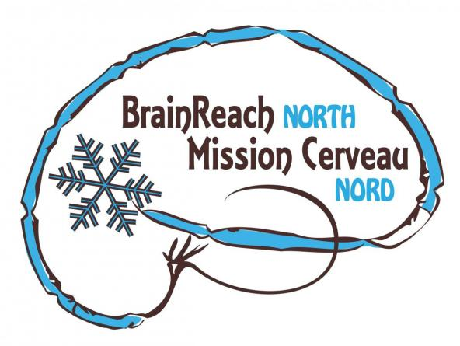
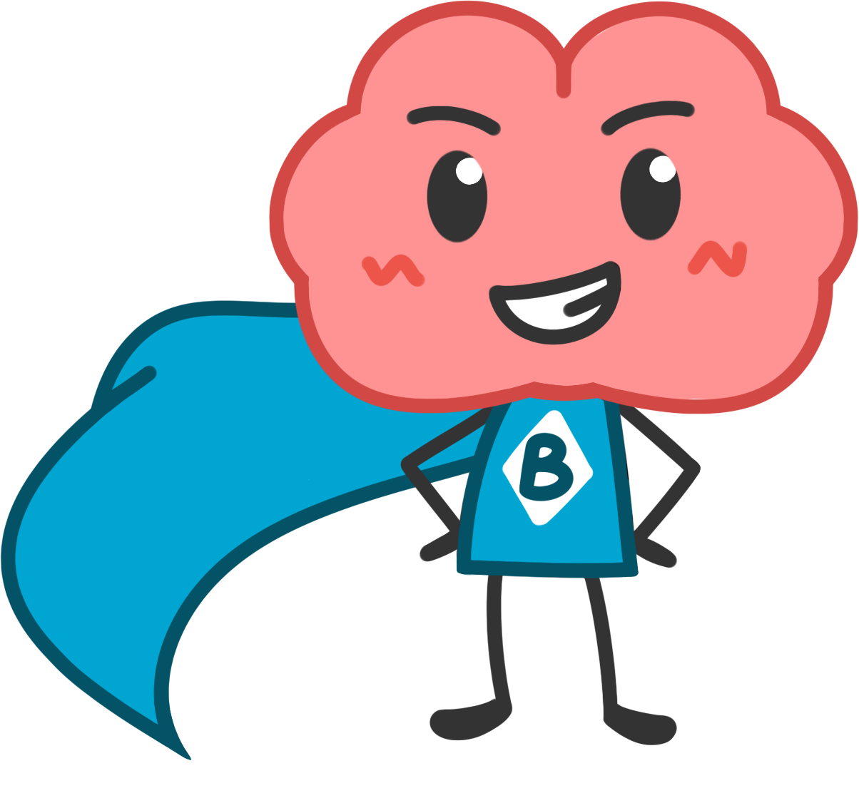
Brain Plasticity and Brain Training
Notes:
General Objectives:
- Present the concept of Brain Plasticity
- Discuss the importance of Brain Plasticity
- Present ways to take advantage of brain plasticity to “train the brain”. This is called Cognitive Training (or Brain Training)
- Present activities that promote Cognitive Training.

Slide 2
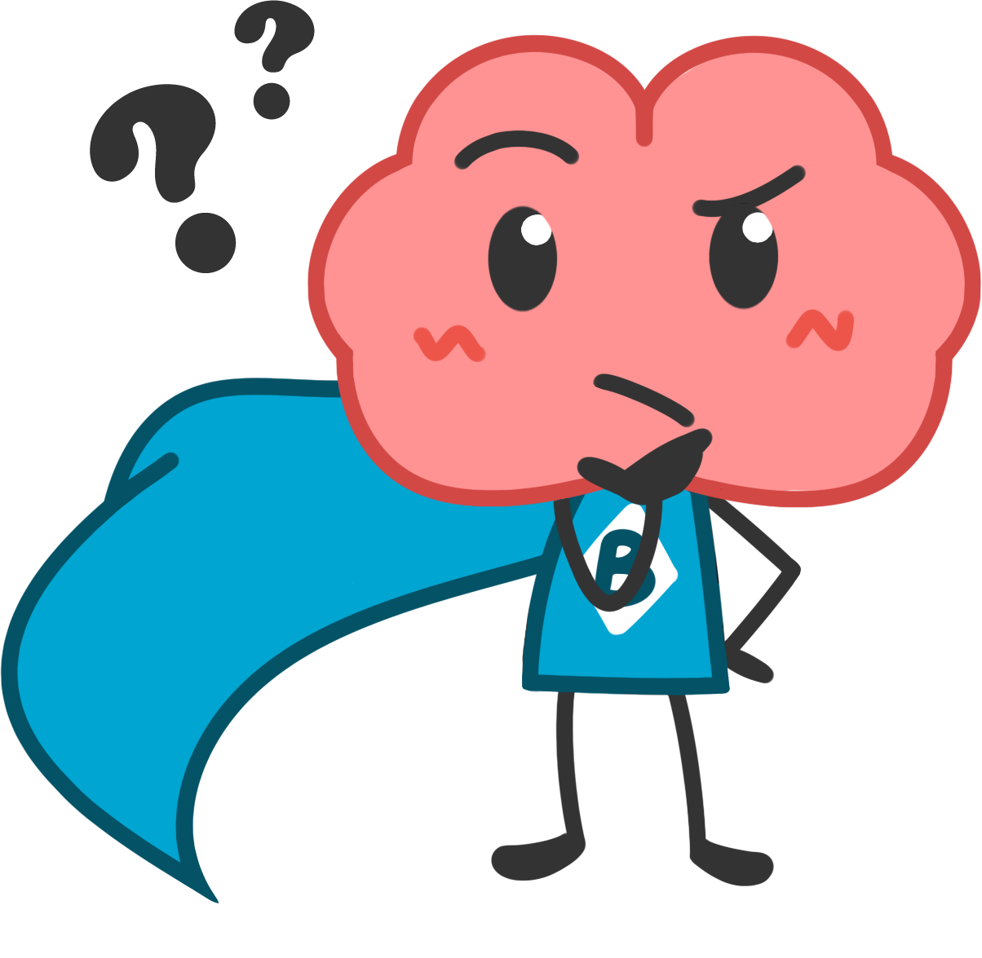
How do the things you do affect your brain?
Notes:
Slide 2: How do the things you do affect your brain?
In other words:
When do you think our brains change?
Are there things that are bad for our brains?
Do you think we can make our brains better? How?
Ask the class to answer the question, either in pairs or as a group.
Some possible answers:
Getting hit in the head can change your brain;
Diseases and drugs can too.
Practicing memory and learning can change it too!

Slide 3
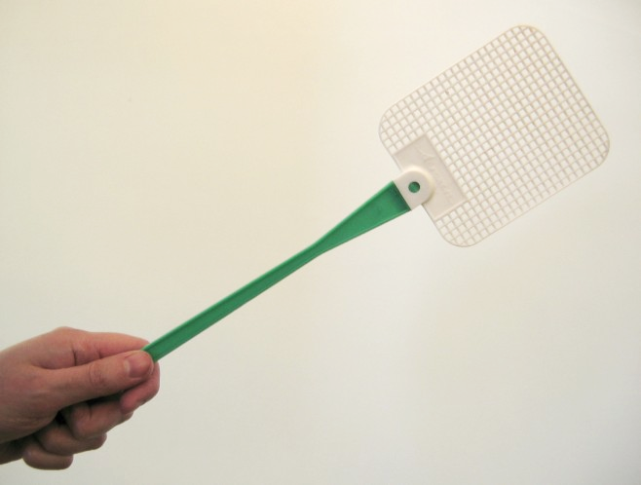
Activity: Ten Different Uses
Look at this object. Can you imagine ten different uses for it?
Be creative!
Notes:
Slide #3: Ten Different Uses
Goal of Activity: exercise cognitive flexibility.
“Cognitive” means things that are related to thinking.
Activity Instructions for Teachers: Ask students to think in many different uses for the object above. Example: A fly swatter might be a spatula, a tennis racket, a golf club, a fan, a baton, a drumstick, a violin, a shovel, a microphone, a baseball bat, or a canoe paddle. We suggest asking students to write down their answers on a piece of paper first and then selecting students to share their answers with each other or with the class.
Extra Material (to help answer students’ questions or further the lesson): Forcing your brain to think of alternatives to the everyday will help keep it strong.

Slide 4
Brain Plasticity
Brain Plasticity is how the brain can change its “wiring” (the connections between the brain cells) - for better and for worse!
It is also called Neuroplasticity.
“Neuro” = from neurons, the cells that send messages in the brain.
“Plasticity” = the possibility to be changed or molded
Notes:
Slide 4: Brain plasticity
Introduction to the terms brain plasticity and neuroplasticity.

Slide 5
Why Does Brain Plasticity Matter?
Neuroplasticity can happen at any age.
Brain Plasticity means that the brain can change and adapt.
This is necessary for learning, remembering, and even shaping your personality. It’s part of what makes you, you!
Notes:
Slide 5: Why does brain plasticity matter?
Why is brain plasticity important? It helps you learn and remember.
Different pathways of connected cells get stronger in different people depending on what they experience. This is how it can end up shaping a person’s personality.
Extra info: Different people will also be more prone to plasticity in different pathways or parts of their brain. For example, some people are very good at learning dance steps or multiplication tables, and others have more difficulty with those. Interactions between what you experience, and how your brain was set up in the first place, affect what a person turns out to do, know, and enjoy.

Slide 6
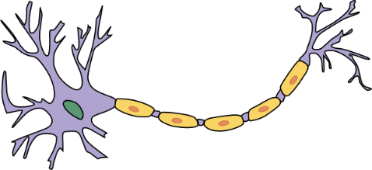
Brain Plasticity
neuron
We have billions of neurons (brain cells) in our brain
Neural connections are the connections between the neurons
These connections are also called synapse
They can be created, changed, or even totally lost, depending on how we use our brain in everyday life.
synapse
neuron
Notes:
Slide 6: Brain plasticity
This slide introduces the concept of plasticity and when it is important in the real world.
Extra background for teachers:
How does this happen? The ways that our brains make new connections are a big area of research for scientists because if we can encourage that, it could improve memory or cognition, especially in people who have impairments like Alzheimer’s patients. Basically, the more you use a connection, the more it strengthens. When your brain uses a certain pathway, it doesn’t just send the signal, it also activates mechanisms in the neurons that make that pathway even stronger.
To learn more about synapses, check out the BrainReach North lesson How Do Neurons Communicate?

Slide 7
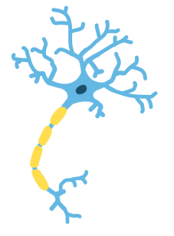
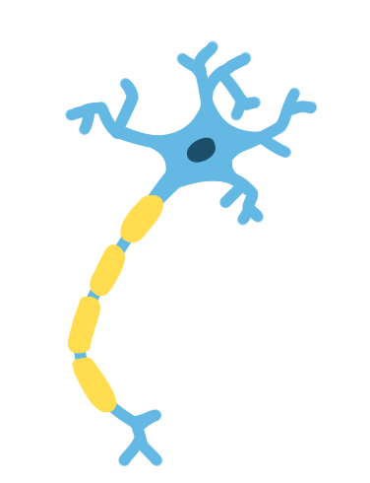
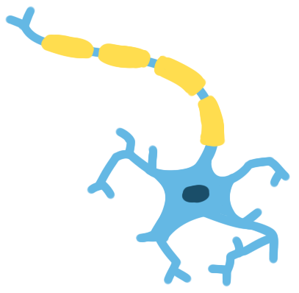
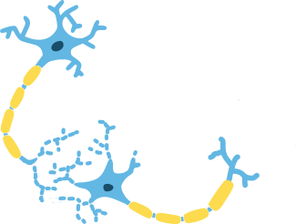
Brain Plasticity
Examples:
When we learn a new dance step, a change happens in our physical brains.
When we forget someone’s name, it’s because the connections that used to hold this information in our brains got weaker.
Can you think of an example of brain plasticity in your own life?
Notes:
Take Home Message: Some connections in the brain get stronger or weaker depending on how much you use it.
When we learn a new dance step, our neurons make new connections that give instructions to our bodies about how to do the new step. Every time we practice, these connections get stronger!
Discussion: Can you think of an example of brain plasticity in your own life?
Have the students come up with examples from their own experience. It would be learning a new language, skill, or forgetting something on a test.
What about something like learning how to ride a bike? If you haven’t ridden a bike for a long time, you might be wobbly at first, but you would quickly remember how to ride a bike again. This is because the connections are weakened but they are still there.

Slide 8
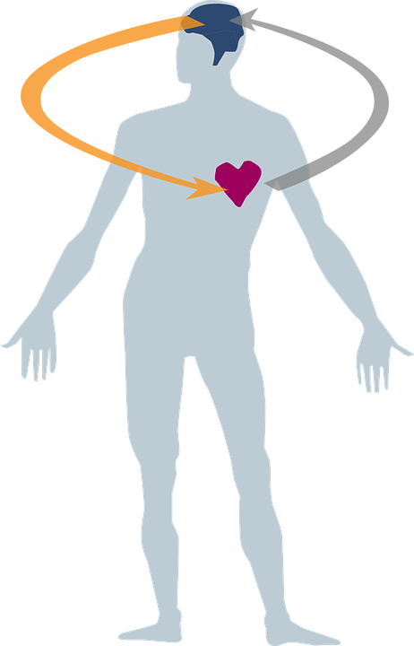
From Brain Plasticity to Brain Training
We can take advantage of Brain Plasticity to keep our brains active and functional - at any age!
Keeping your brain active is as important as keeping your body active in order to stay healthy.
Notes:
Slide 8: From Brain Plasticity to Brain Training
Take Home Message: This slide introduces the goals of the activities - to practice “brain training” to put what we know about plasticity to use.
Extra info: New experiences, especially the ones combining physical senses - vision, smell, touch, taste and hearing - and emotional “sense” stimulates more connections between different brain areas, causing production of brain nutrients that help memory and makes the cells involved stronger and more resistant to the effects of aging.

Slide 9
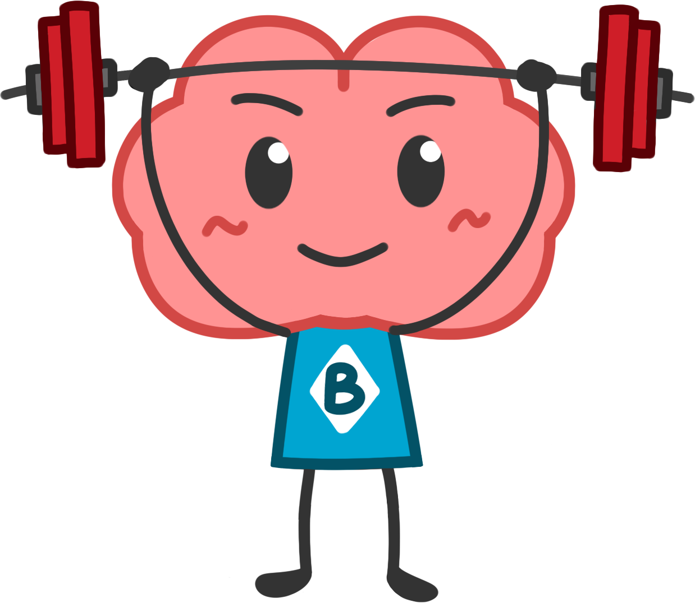
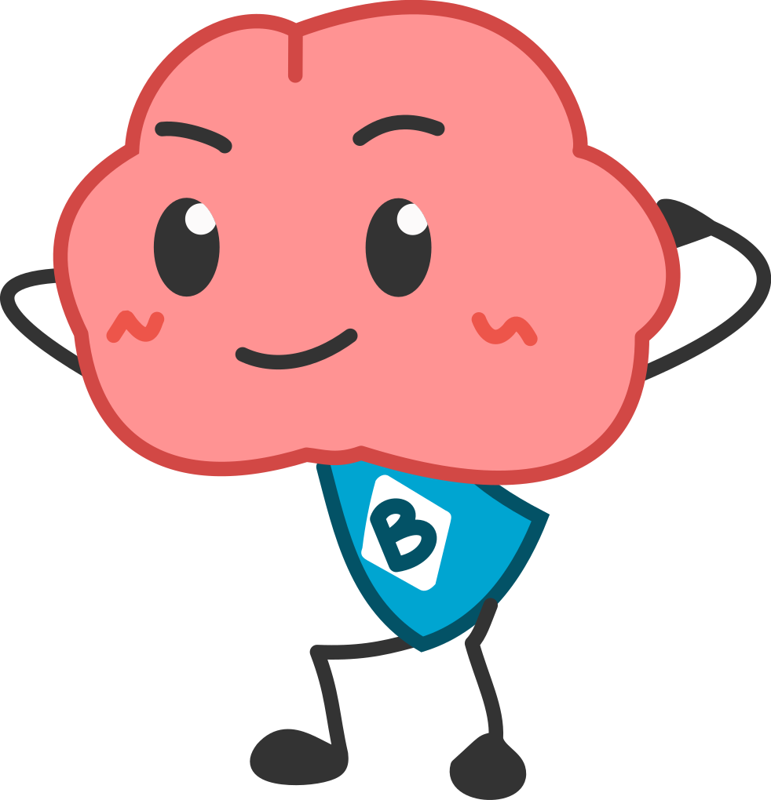
From Brain Plasticity to Brain Training
The act of ‘training’ our brains is called Cognitive Training (or Brain Training).
We can do exercises that will put our brains to work in different ways than we’re used to.
Notes:
Slide 9: From brain plasticity to brain training
Cognitive Training is like a workout for your brain! It can improve memory, attention, concentration and keep your brain “active” and “faster”.
Take Home Message: This slide connects the theory of neuroplasticity to some practical ways to use it.
Extra info for teachers:
New experiences, especially the ones combining physical senses - vision, smell, touch, taste and hearing - and emotional “sense” stimulates more connections between different brain areas, causing production of brain nutrients that help memory and makes the cells involved stronger and more resistant to the effects of aging.
“Cognitive” means things that are related to thinking.
Brain training can help more than just the specific things you’re “training” - keeping your brain good at learning (encouraging plasticity) will make it easy to learn all sorts of things by activating the mechanisms that encourage plasticity in the brain. You can make an analogy to how lifting weights, say by doing bicep curls, can make a person better at playing hockey or soccer by conditioning their muscles.

Slide 10
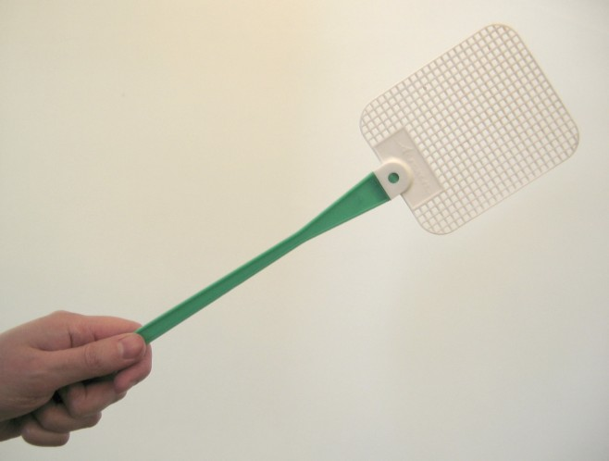
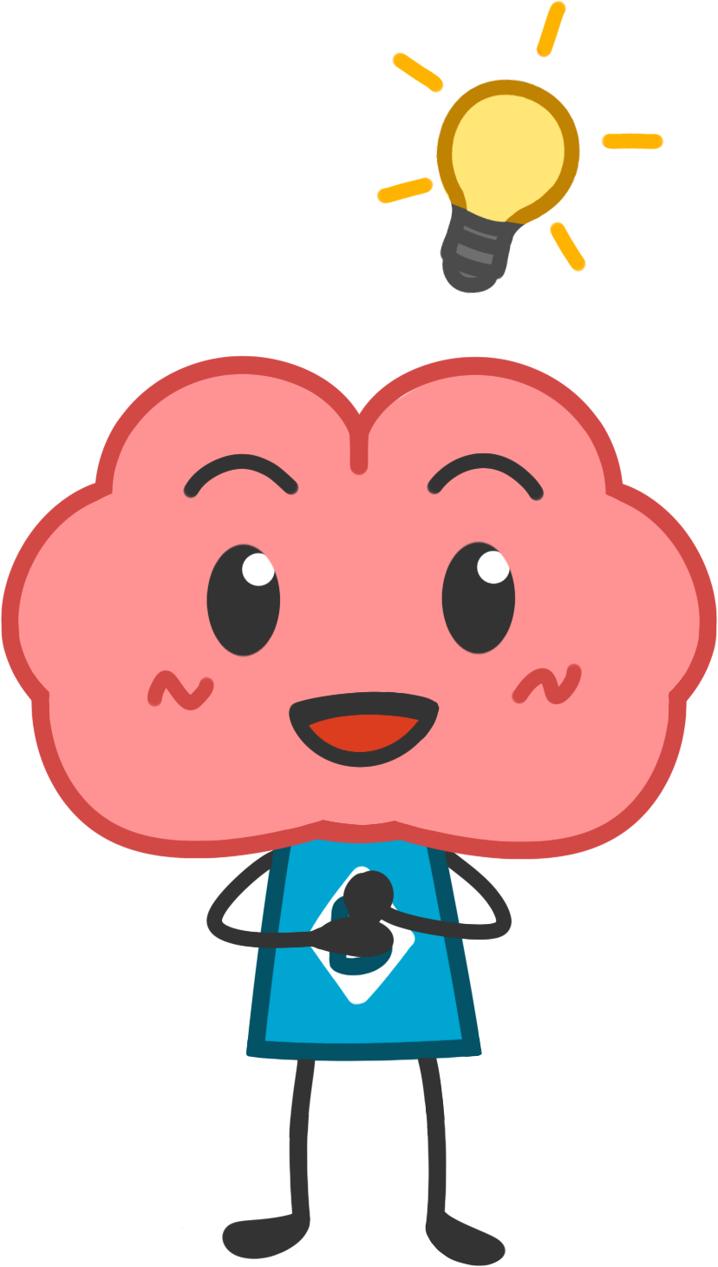
Remember the activity at
the start of the lesson?
When you think of different, unusual uses for something, you are exercising your brain and helping to keep it strong and creative!
Can you think of other ways to exercise your brain? (hint: maybe you already do some of them!)
Notes:
Slide 10: Remember the activity at the start of the lesson?
That activity was a brain training. So, you got a little smarter at the start of this class!
Here are other brain training exercises you can do.
Learning a second language
Learning how to play a musical instrument
Doing math
Learning a new sport or getting better at one you play
Strategy video games and board games
Spending time with people and meeting new people
Purpose: Tie in the activity from the start of this lesson to the concepts of brain training and neuroplasticity.
Extra info / discussion
There is lots of research (especially from Quebec!) about how speaking more than one language can help with all sorts of things, even a person’s ability to do math. A lot of this has to do with cognitive training -- using a different language changes the way you think and which pathways you use, so if you use two languages regularly, you’re keeping your brain good at adapting and doing new things.
It’s not just studying that counts as “brain training”. Any new experiences can be beneficial. Some video and board games are really just problem-solving, which is great for your brain. Our brains are also set up to like being with people, so conversation and friendship is also a good way to keep your brain firing.

Slide 11
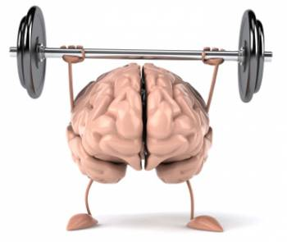
Let’s train our brains even more!
Notes:
Slide 11: Let’s train our brains even more!
The following slides present a series of simple brain training activities for students to do in class or on their own.

Slide 12
Activity 1: Using the Other Hand
Write your name with the hand you usually use to write.
Now try to write your name with the hand you don’t always use to write.
Do it more than once. Try to draw something that you are very good at drawing with your “writing” hand.
Compare the results!
Notes:
Slide 12: Activity: Using the Other Hand
Goal of Activity: Encourage students to use the non-dominant hand to write.
Activity Instructions for Teachers: Give students paper and pen and ask them to write their names (and anything else they want) with the opposite hand to the one they use to write. Ask them to write the same with the dominant hand paying attention to the differences both in the process of writing (how difficult it is, etc) and to the results (how their calligraphy looks like, if it is aligned, etc). Ask them to try more with the non-dominant hand, trying to improve the quality of the writing to approach the one produced by the dominant hand.
Extra Material (to help answer students’ questions or further the lesson): Encourage students to try the same with others task of daily life. Brushing teeth, eating, or brushing their hair with their non-dominant hand will also activate some new neurons.

Slide 13
About “Using the Other Hand”
How did it feel? Was your “non-writing hand” as good as your “writing” hand?
How do you think brain plasticity is related to being better at writing with one hand than the other?
Did you get better with practice? What about when you concentrated harder?
Do you think people can be as good at writing, drawing or playing with both hands? How?
Notes:
Slide 13: About “Using the other hand”.
Goal of Activity: Understand why just writing with your non-dominant hand makes a difference.
Activity Instructions for Teachers: Ask students to discuss the answers in small groups.
Extra Material (to help answer students’ questions or further the lesson):
Answers:
It’s harder to write and drawn with your non-dominant hand (the one you do not usually use to do it) because the neural connections between that hand and the areas of your brain that are responsible for controlling writing are not as strongly wired as they are for the dominant one.
Research has shown that using the opposite side of your brain (as in this exercise) can result in a rapid and substantial expansion of in the parts of the brain that control and process tactile information from the hand, thus making this kind of task easier and more accurate with time!
People who are good at writing (or playing sports, or drawing…) with both hands are called ambidextrous. These people have strong pathways for these kinds of motor control on both sides of their brains. This could be because they practiced both sides early, or because their brain was set up to make that easier from the beginning.

Slide 14
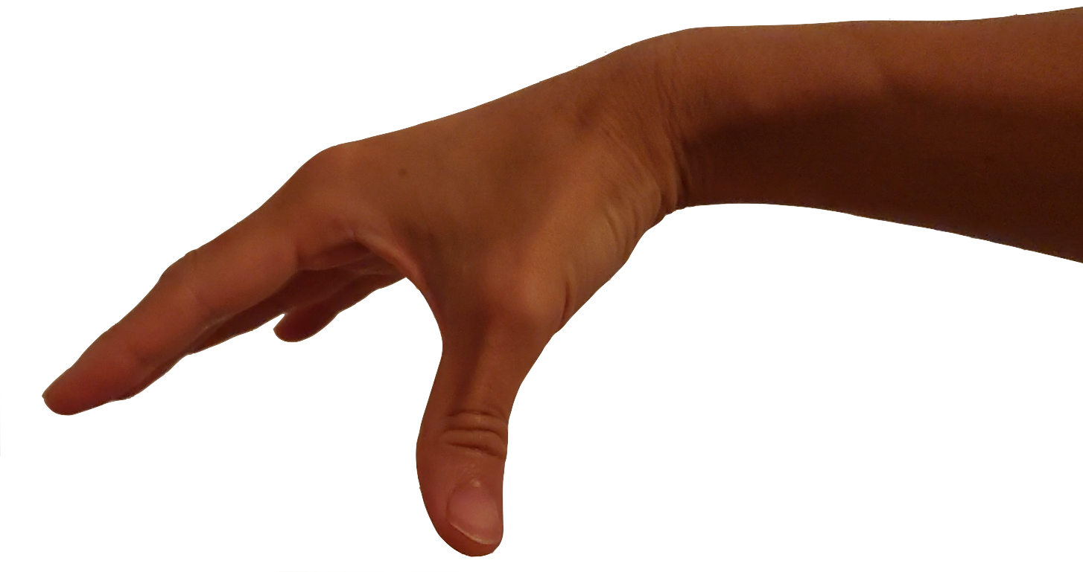
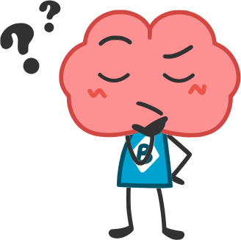
Activity 2: Guessing Without Sight
Instructions:
Sit in groups or pairs.
One person closes their eyes and another person in each pair or group shakes an object and then drops it on the floor.
The person with their eyes closed needs to try to guess what the object is without looking at it.
Tips: Pay attention to the details you hear. Did it make noise when shaken? Did it sound loud or soft when it hit the floor? What shape can it be?
?
Notes:
Slide 14: Guessing without sight
Goal of Activity: Identifying known objects using other senses than vision.
You will need: objects that make distinct sounds
Activity Instructions for Teachers: We suggest objects you can find around the classroom, like a marble, an eraser, a feather, a cotton ball, a screw, small toys, tiny things in containers and other things with unique shapes, textures and sound. Encourage students to change places after a few trials so everyone has a chance to guess the objects.

Slide 15
Activity 2: Guessing Without Sight
Instructions:
Sit in groups or pairs.
One person closes their eyes and another person in each pair or group picks an object from the box and give it to the person with their eyes closed.
The person with their eyes closed needs to try to guess what the object is without looking at it.
Tips: Try to use your other senses. Does it have a smell? How does it feel to the touch? What shape is it? Does it has moving parts? Does it make any noise?
Notes:
Slide 15: Guessing without sight (in-person version)
Goal of Activity: Identifying known objects using other senses than vision.
You will need: box full of “secret objects”.
Activity Instructions for Teachers: We suggest objects you can find around the classroom, like a marble, an eraser, a feather, a cotton ball, a screw, small toys, spices in containers and other things with unique shapes, textures or smells. Encourage students to change places after a few trials so everyone has a chance to guess the objects.

Slide 16
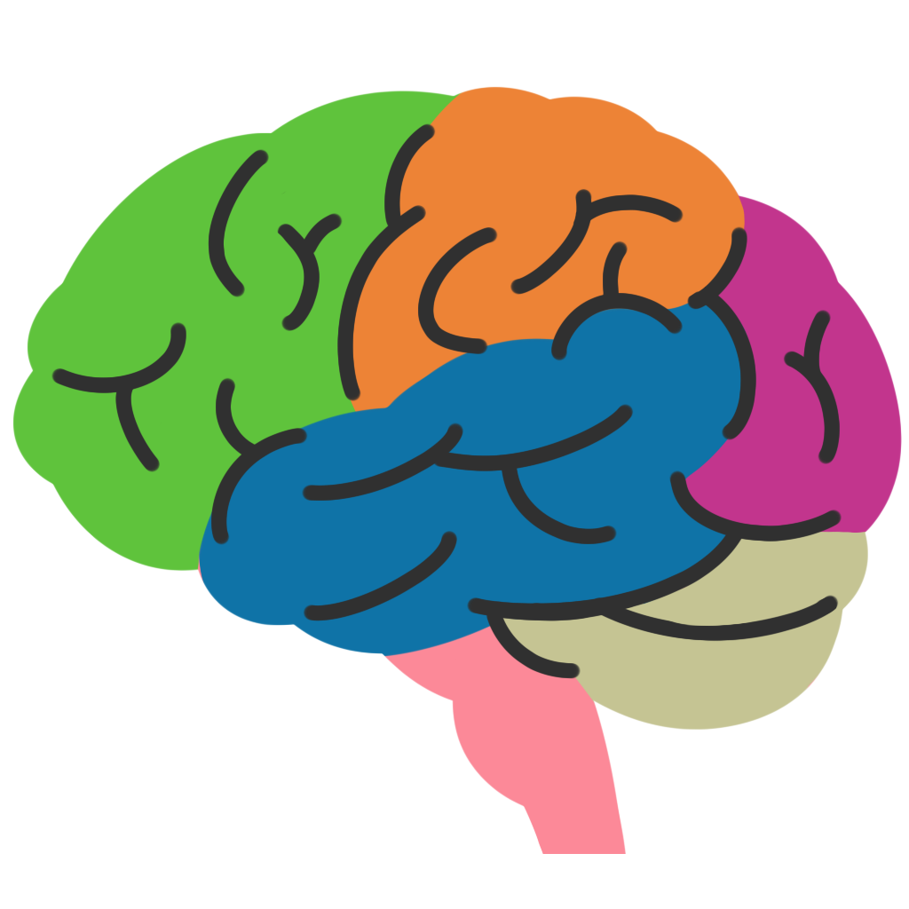
About “Guessing Without Sight”
Normally, you look at something to figure out what it is - your brain uses visual cues.
Using your other senses to identify things activates and forms new connections in brain areas responsible for touch and smell information.
We can see these change when we look at the brain - the connections and brain cells in these new areas are actually bigger!
I feel this object is a toy
I see this object is a toy
Notes:
Slide 16: About “Guessing Without Sight”
Purpose: A short discussion to explain how activities like the one the class just did can help you train your brain.
Extra info:
How do we know this? Scientists have done MRI scans to see how big the brain areas responsible for language and music are in people who speak many languages or people who play an instrument, and we can measure how thick the cortex (outer layer of the brain) is in these areas. We can also see how strong connections are by using MRIs to analyze white matter - the actual axons connecting different regions. In animals, like in lab experiments with rats and mice, we can actually count the connections between different neurons and brain regions.

Slide 17
Activity 3: Drawing a Map
You will need:
A sheet of paper
Pencils, crayons, etc.
Instructions:
Picture your school in your mind and
draw a map of it from memory.
Try to include as many details as you
can remember. Be sure to keep the
size of everything in mind when drawing
(is your classroom bigger than the principal’s office?)
Notes:
Slide 17: Activity: Drawing a Map
Goal of Activity: Training spatial memory.
Activity Instructions for Teachers: Ask students to drawn a map of their school using their memory, following proportion and locations as well as they can. They can compare their maps with the student beside them to see how they vary, who included more details, etc.

Slide 18
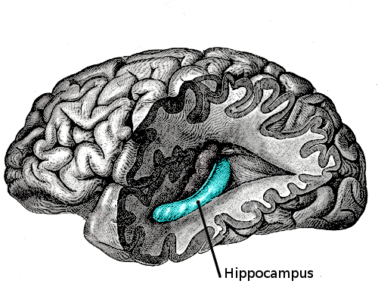
About “Drawing a Map”
This activity helps you to exercise your spatial memory. This is the memory you use to figure out where you are, learn directions, and know how to get from one place to another.
Next time you walk through your school, you will pay more attention to how things are set up around you.
This will exercise your hippocampus, the part of your brain that remembers places.
Notes:
Slide 18: About “Drawing a Map”
Purpose: Discuss why drawing a map helps with brain training and plasticity.
Extra info for teachers: The hippocampus is a small structure, but we know that activity can cause big changes in it. For example, taxi drivers in London, England, have to memorize a huge and complicated map of the roads of the city to do their jobs, and they use that information every day. Scientists found that their hippocampus is bigger than yours or mine. (Study: Maguire, Woollett, and Spiers (2006) in the journal “Hippocampus”).

Slide 19
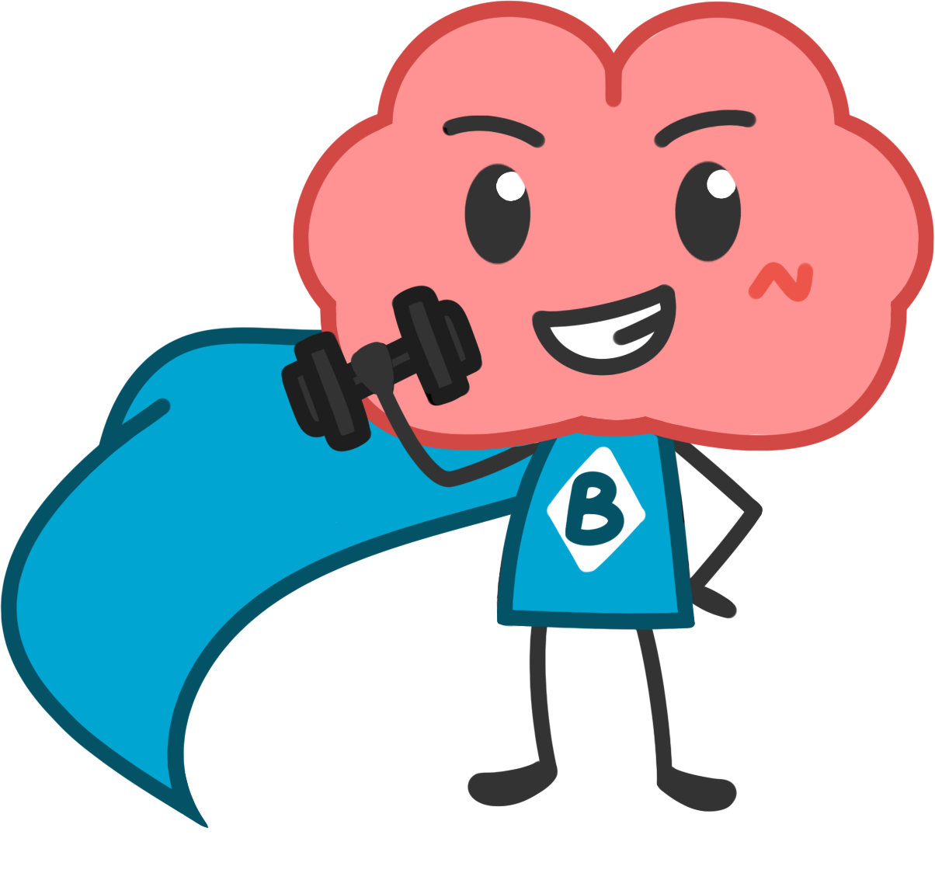
Bonus!
When you go to a new place, try to make a map of the place when you get back home: close your eyes and remember being in the place, picturing where things were.
With time, you’ll train your brain to become a great mapmaker (and you won’t get lost as often!)
Notes:
Slide 19: Bonus!
Extra tips for spatial memory training.

Slide 20
What did We Learn Today?
Our life experiences - even just what we think about - can change our brains. This is called Brain Plasticity or Neuroplasticity.
We can use brain plasticity to keep our brains active and healthy by doing “brain exercises”. This is called Cognitive Training or Brain Training.
If you do it regularly, brain training can improve memory, attention, concentration, and reduce the effects of aging.
Notes:
Slide 20: What did we learn today?
Take Home Message: Brain plasticity is a way to exercise the brain, increasing cognitive function. Anyone can do it, but it has to be done regularly to work. There are many ways to increase brain plasticity through brain training, some of which were exercised or suggested in this lesson.

Slide 21
More things you can do to challenge your brain:
Try to remember a list of items without a cheat sheet (like your grocery list or the names of all your classmates)
Take up a new hobby that involves a lot of hand ability, such as beadwork, drawing or painting.
Challenge yourself to do two or more things at once! Learn all the lyrics of a song while you do the dishes, or practice a new language while you go for a walk.
Notes:
Slide 21: More things you can do to challenge your brain
Extra suggestions for how students can try this out at home.

Slide 22
brainreachnorth@gmail.com
www.brainreachnorth.ca
Notes:
Thank you for using the lesson! Please contact the BrainReach North team anytime at brainreachnorth@gmail.com if you or your students have further questions about this topic or activity.
You can provide feedback on this lesson plan using this form: http://goo.gl/forms/oi0ofj03HM

